Slide 1
What is back End Development ?

Slide 2
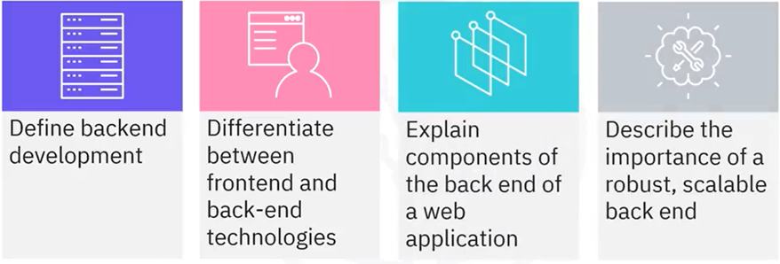
What you will learn

Slide 3


Front end Vs back end
Browser engine
Front-end client
Back – end server

Slide 4

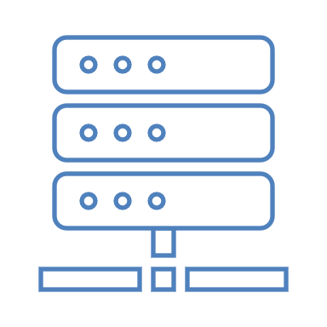

Back End
• Back-end developers write code to communicate with the
browser's engine and back-end server
Databases
Servers
Applications
Code

Slide 5
Back-end technologies
• Includes: servers, databases, web APIs, programming languages, frameworks, and runtimes
• Severs can refer to hardware, software, or both
• Servers communicate with and provide functionality to a client
• Servers also communicate with and provide functionality to each other

Slide 6

Types of servers
Database
Application
Web

Slide 7

Database servers
• House, retrieve, and deliver data
• Database server and database often used interchangeably

Slide 8
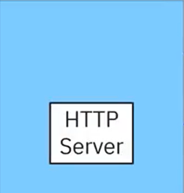
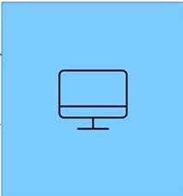
Web and HTTP servers
HTTP Request
HTTP Respones
Web server
Client

Slide 9
Application Servers
• Host and deliver the application through HTTP
• They sit between a database server and a web server
• Transform data into content
• Run business logic
• Data storage rules
• Data transfer rules

Slide 10
Web APIs
• How two pieces of software communicate
• Web services
• Type of a web API
• Communicate using HTTP
web APIs
Web Services

Slide 11
Back-end languages
Java
PHP
JavaScript
C#
Python
Ruby

Slide 12
Frameworks
• Provide structure for code
• Generates code that cannot be altered
• Back-end frameworks include:
• Django (Python)
• Ruby on Rails (Ruby)
• Express.js (JavaScript)
• Express.js
• Framework that runs on top of Node.js

Slide 13

Runtime environments
• Like a mini operating system that provides the resources necessary for an application to run
• The infrastructure that supports the execution of a codebase
• The environment in which an application gets executed
• Node.js is a back-end runtime environment

Slide 14
Node.js
• Runs on Google Chrome's V8 engine
• The V8 engine also runs on the client's front-end browser
• Executes JavaScript
• JavaScript can be used on the front end and on the back end

Slide 15


Backend responsibility: Scalability
Load
Number of concurrent users
Number of concurrent data
transactions
amount of concurrent data transfer between clients and servers
Scalability
Application's ability to handle
changes in load without
affecting performance
Essential for client-server
application success

Slide 16




Other back- end responsibilities
Security
Authentication
Malware
Prevention
Performance

Slide 17
Recap
In this video, you learned that:
• Back-end development refers to the development of the
server-side logic
• Front-end technologies pertain to the client
• Back-end technologies include various types of servers and
supporting infrastructures
• The back end is responsible for scalability, security, and
performance

